Slide 1



Slide 2



Welcome
Email
Password
Sign in
You don’t have any accounts? Create one!
Eng – Viet Dictionary

Slide 3


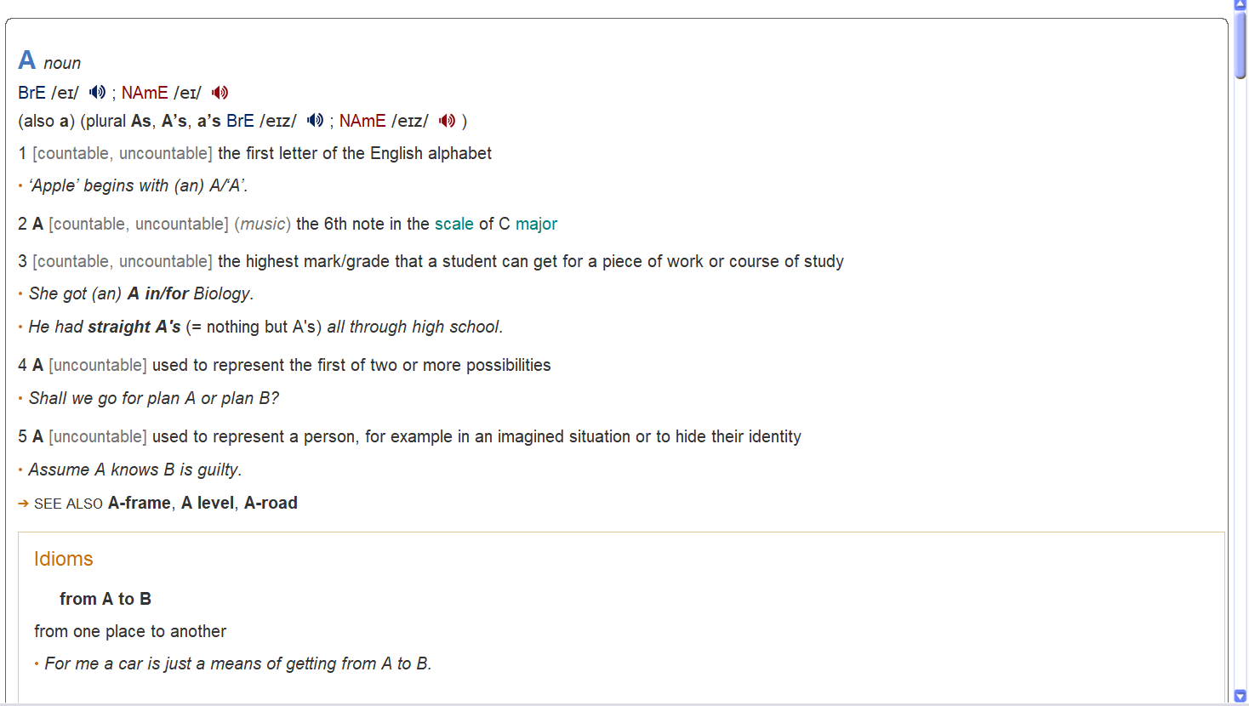
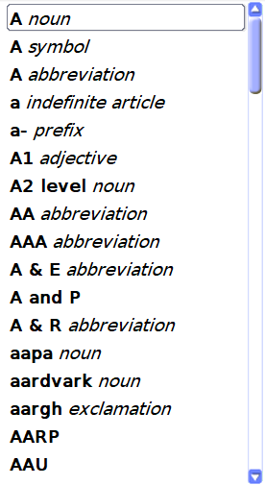
English – Vietnamese Learner’s Dictionary
Username
Search
Index

Slide 4
English – Vietnamese Learner’s Dictionary
Username
Search
Welcome Username!
Index
Sign out

Slide 5

English – Vietnamese Learner’s Dictionary
Username
Search
Index

Slide 6







English – Vietnamese Learner’s Dictionary
Username
MENU
Search
Home
Index
Saved word
Translate Online
Import from file
Game
Settings
Information

Slide 7
Eng – Viet Dictionary
Pasword
Enter your password
Forgot password?
Back
Next

